Slide 1


Parallelization and synchronization tool
Local search‐based Metaheuristics
Travelling salesman problem (TSP)
Yves Mbonigaba
Valerian Menin
DI 3 – Group1

Slide 2
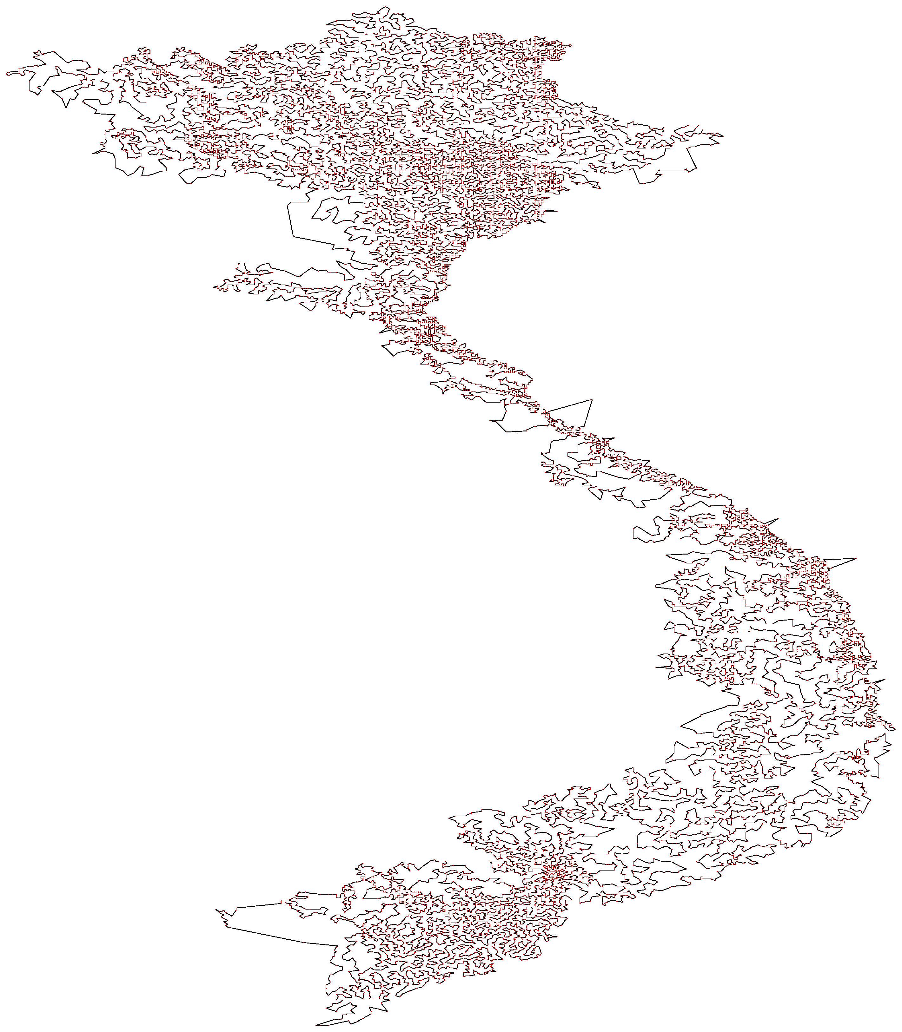

Our problem :
• find a good solution for the travelling salesman
Our specifications :
• find a good solution as fast as possible
• use different threads to process data
Vietnam
Djibouti
2
Tips : we are not looking for the best solution, only a good one

Slide 3
How did we parallelized our algorithm ? (MyTsp.java)
1. define the number of threads that we are going to use
(threads = 1 for a serial, 2, 3, 4, 5, 6, 7 or 8)
2. define the number of task we will explore
(the number of solution to explore : iterations = 100)
The more it is, the best chance we have to find the best solution but the slower it is.
3. create all tasks
4. execute all tasks to get several best local solution
The ExecutorService manage what each thread in purpose to keep it busy and never waste our time.
5. compare all results to get our best solution
6. return our best solution
3

Slide 4

How did we implement our searcher ? (LocalSearcher.java)
TSPCostCalculator
1. the LocalSearcher is initialized by using a random solution and
ThreadLocalRandom.current() to have different random is each thread
2. optimize le random solution S0
We begin by a 2Opt, when it is optimized, we go on a relocate and then
in a swap. At any time, if we find a better solution, we set the solution
and run the method above again until it is fully optimized or until the
number max of changed is reached.
4

Slide 5
As shown on the graph, we created a file result.csv in which we write the most important information.
We can use this data to show up that our algorithm is 3 times speeder than a serial for 4 threads
and 4,6 times speeder for 8 threads.
Tips : the best that we could imagine is the number of threads.
5
Our results are quit good but we becomes long when there are many nodes.

